Slide 1

01
Impact of COVID-19 on ABC Company's Parcel Delivery
COMP-603-T06 Programming for Data Science
Group 12
Mohmed Yasar Shaikh| Patel Harshkumar | Patel Jap

Slide 2

02
Background
COVID-19 affected Canadian businesses in different ways.
Some sectors grew because of higher e-commerce demand.
Some businesses faced lower sales and shipping activity.
ABC Company’s customers were impacted differently across sectors.
Parcel data from 2019 and 2020 helps show this business impact.

Slide 3

03
1
Dataset Overview
Objective
Analyze how COVID-19 impacted ABC Company’s parcel business.
2
3
Identify first disruption and recovery periods.
4
Compare weekly parcel volumes in 2019 and 2020.
5
Measure impact on customer groups and revenue.
6
Evaluate peak season changes during COVID.
7

Slide 4

04
Dataset Overview
Metric | Value
Records | 104,571
Customers | 1,061
Years | 2
Groups | 4
Missing Values | 0

Slide 5

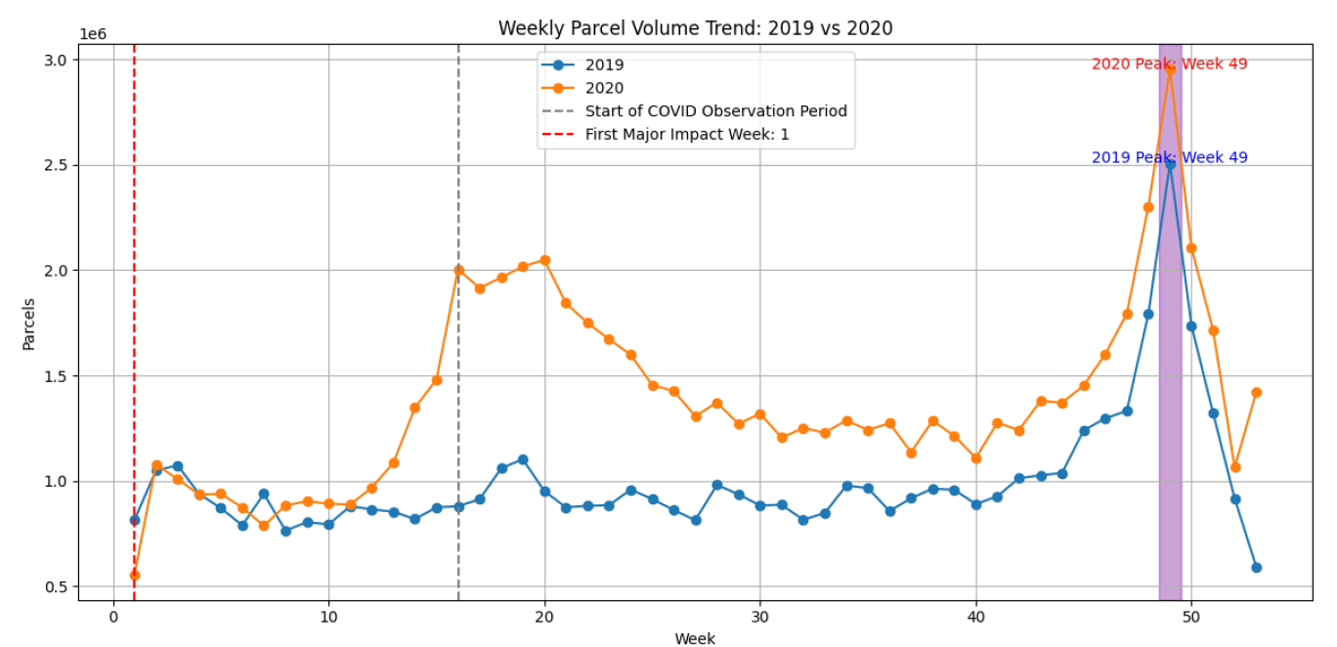
5
How Did COVID-19 Impact ABC Company’s Parcel Business?
Parcel volumes in 2020 were higher than 2019 for most weeks.
First major disruption appeared at Week 1 of 2020.
Strong growth started after the COVID observation period around Week 16.
2020 maintained higher weekly demand through most of the year.
Peak season reached highest volume at Week 49, above 2019 peak

Slide 6

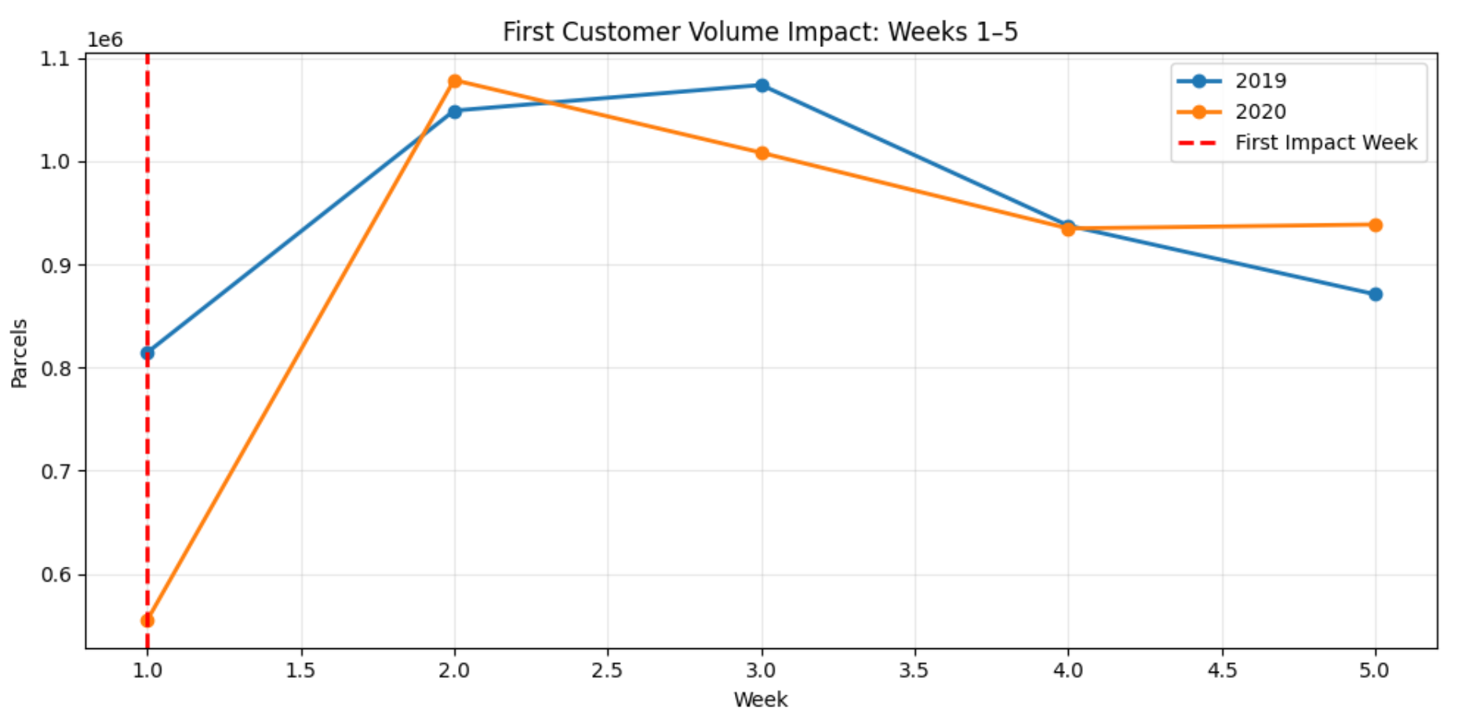
06
When Were Customer Volumes First Impacted by COVID-19?
First major impact occurred in Week 1 of 2020.
Parcel volume fell to 554,951 in 2020 compared to 814,361 in 2019.
This was a decline of 259,410 parcels and percentage decrease was 31.85% versus Week 1 of 2019.
It indicates early COVID-related uncertainty before full lockdowns.

Slide 7

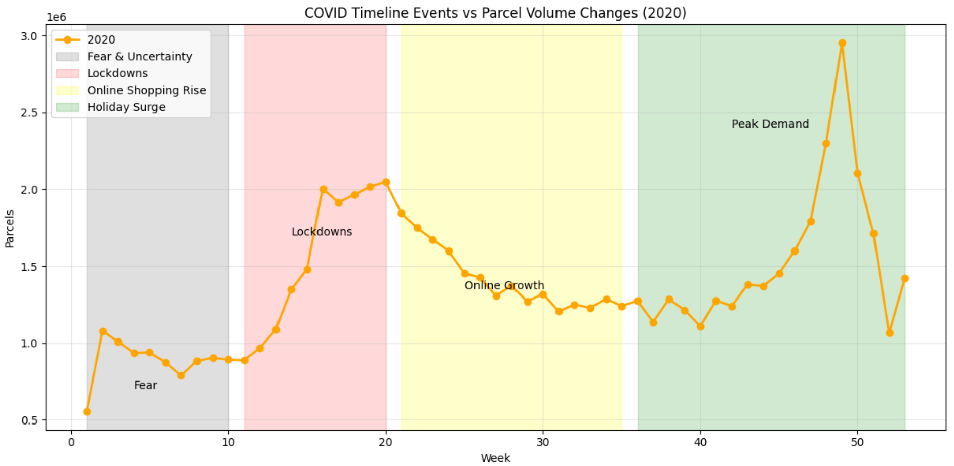
07
What Events Within the COVID Timeline May Have Contributed to the Change?
Weeks 1–10: Fear and uncertainty kept demand low (0.8M–1.0M).
Weeks 11–20: Lockdowns raised parcel volumes above 2.0M.
Weeks 21–35: Online shopping kept demand stable (1.3M–1.7M).
Weeks 36–53: Holiday season created strong growth.
Peak reached 3.0M parcels in Week 49.

Slide 8

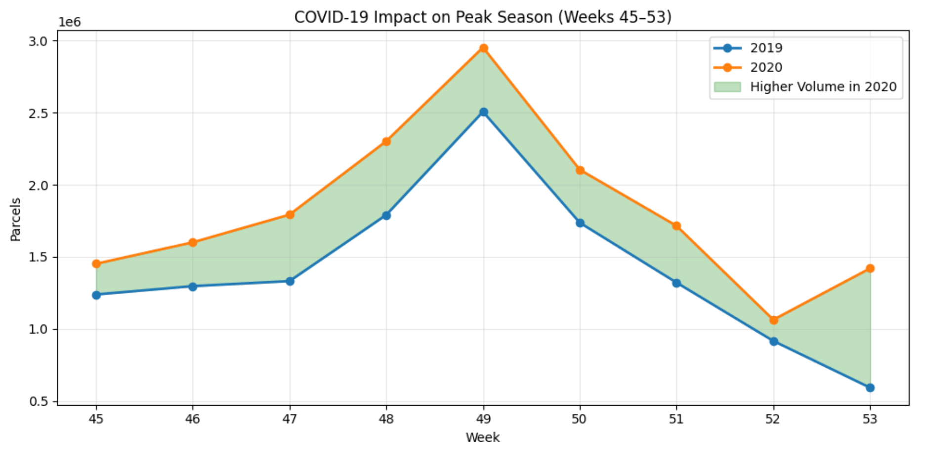
08
What Events Within the COVID Timeline May Have Contributed to the Change?
2020 peak season volumes were higher than 2019.
Strong demand seen during Weeks 45–53.
Online shopping boosted late-year shipments.
Highest peak came in Week 49.
COVID increased holiday parcel demand significantly.

Slide 9

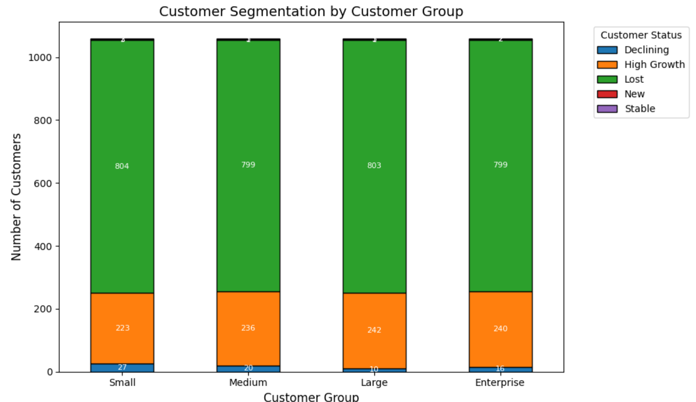
09
How Has COVID Affected Different Customer Groups?
Small: 223 growth, 804 lost.
Large: 242 growth, 803 lost.
Enterprise: 240 growth, 799 lost.
Around 75% of customers were classified as lost overall.
Small group had the highest lost customer count (804).

Slide 10

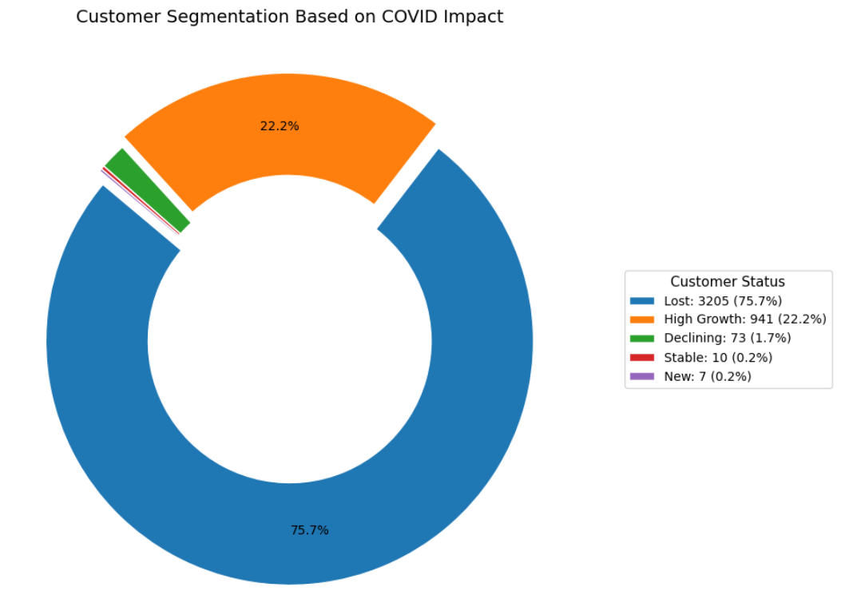
What percent of each customer group is growing, moderately growing, and declining during the COVID observation period?
10
High Growth customers accounted for 22.2%.
Declining customers were only 1.7%.
Moderate/Stable customers were 0.2%.
Most customers were either growing or lost during COVID

Slide 11

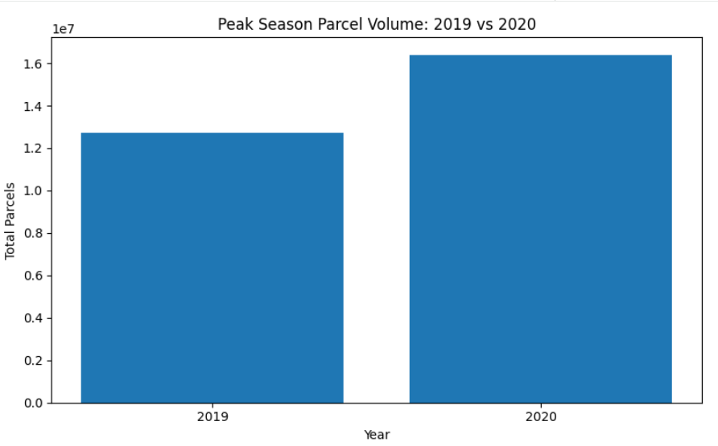
11
Evaluate peak season changes during COVID.
Peak season volume increased in 2020 compared to 2019.
2019 peak season handled 12.73M parcels.
2020 peak season reached 16.40M parcels.
Increase of 3.67M parcels (+28.84%).
COVID boosted holiday and online shopping demand.
Revenue estimated using $22 average parcel price

Slide 12

12
Final Summary & Insights
COVID-19 initially disrupted parcel volumes but recovery was rapid.
2020 shipments exceeded 2019 levels for most of the year.
Peak season volume increased 28.84% during COVID.
Large and Enterprise customers showed strongest growth and resilience.
E-commerce demand became the key driver of business growth.

Slide 13

13
Final Recommendations
Expand infrastructure for future peak demand.
Track high-growth customers for expansion opportunities.
Re-engage lost customers with targeted offers.
Strengthen Enterprise and Large customer relationships.
Use past peak trends for future forecasting.

Slide 14

THANK YOU

